Slide 1

SOFTWARE ENGINEERING
Week 2
Introduction – Software Development Lifecycle

Slide 2
Agenda
Software Processes
Plan Driven Software Process Models

Slide 3

Software Processes
Software Processes
Plan Driven Software Process Models

Slide 4
The Meaning of Process
A process: a series of steps involving activities, constraints, and resources that produce intended output of some kind
A process involves a set of tools and techniques

Slide 5
Reasons for Modeling a Process
To form a common understanding
To find inconsistencies, redundancies, omissions
To define and evaluate appropriate activities for reaching process goals
To tailor a general process for a particular situation in which it will be used

Slide 6
Software Life Cycle
When a process involves building a software product, the process may be referred as software (development) life cycle
Requirements analysis and definition
System (architecture) design
Program (detailed/procedural) design
Writing programs (coding/implementation)
Testing: unit, integration, system
System delivery (deployment)
Maintenance

Slide 7
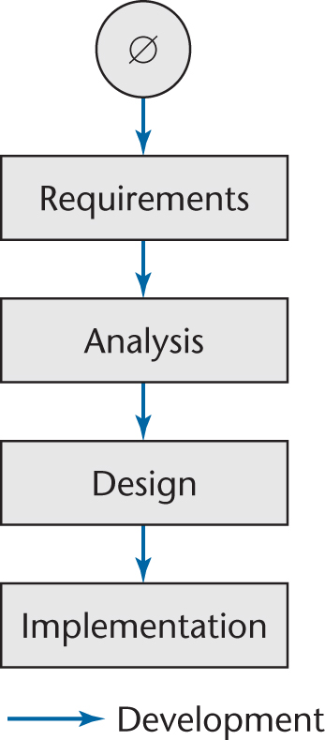
Software Development
Ideally, software is developed as described in
Linear
Starting from scratch
In the real world, software development is totally different
We make mistakes
The client’s requirements change while the software product is being developed
Figure 2.1

Slide 8
Moving Target Problem
A change in the requirements while the software product is being developed
Even if the reasons for the change are good, the software product can be adversely impacted
Dependencies will be induced
Any change made to a software product can potentially cause a regression fault
A fault in an apparently unrelated part of the software
If there are too many changes
The entire product may have to be redesigned and reimplemented
Change is inevitable
Growing companies are always going to change
If the individual calling for changes has sufficient clout, nothing can be done about it
There is no solution for the moving target problem

Slide 9
Iteration and Incrementation
In real life, we cannot speak about “the analysis phase”
Instead, the operations of the analysis phase are spread out over the life cycle
The basic software development process is iterative
Each successive version is intended to be closer to its target than its predecessor

Slide 10
Miller’s Law
At any one time, we can concentrate on only approximately seven chunks (units of information)
To handle larger amounts of information, use stepwise refinement
Concentrate on the aspects that are currently the most important
Postpone aspects that are currently less critical
Every aspect is eventually handled, but in order of current importance
This is an incremental process

Slide 11
Plan Driven Software Process Models
Software Processes
Plan Driven Software Process Models

Slide 12
Plan-Driven Software Process Models
Code-and-fix model
Waterfall model
Incremental model
Rapid prototyping model
Iterative model
Unified Process model
Component-Based model
In practice, most large systems are developed using a process that incorporates elements from all of these models.

Slide 13
1. Code-and-Fix Model
Implement the 1st Version
Development
Modify until client is satisfied
Maintenance
Post-delivery Maintenance
The easiest way to develop software
No design, no specifications
Maintenance extremely difficult
The most expensive way
Typically used by a start-up

Slide 14
2. Waterfall Model
Requirements
Analysis
Design
Coding
Testing
Deployment
Maintenance
Separate and distinct phases
Feedback loops
Documentation-driven

Slide 15
2. Waterfall Model Pros and Cons
Pros
Cons
Simple and disciplined, structured approach
Project Management is easy
Maintenance is easier
Difficulty of accommodating changes after the process is underway.
Necessitates stable requirement
Few business systems have stable requirements.
Military, Government Projects
Major design problems may not be detected till very late.
Very late delivery
Blocking phases
Coders must wait designers to prepare design document
This model is only appropriate when the requirements are well-understood and changes will be limited during the design process.
The waterfall model is mostly used for large system engineering projects where a system is developed at several sites.
In those circumstances, the plan-driven nature of the waterfall model helps to coordinate the work.

Slide 16
3. Iterative/Incremental Development
Requirements
Release 1
Design Code Test Maintenance
Release 2
Design Code Test Integrate Maintenance
Release 3
Design Code Test Integrate Maintenance
Avoids “big bang” implementation
Assumes all requirements are known up-front
Each release adds more functionality
Once the development of an increment is started, the requirements are frozen though requirements for later increments can continue to evolve.

Slide 17
Iteration and Incrementation (contd)
Incremental
Iterative
Figure 2.5

Slide 18
3. Incremental Development Pros and Cons
Pros
Cons
The cost of accommodating changing customer requirements is reduced.
The amount of analysis and documentation that has to be redone is much less than is required with the waterfall model.
It is easier to get customer feedback on the development work that has been done.
Customers can comment on demonstrations of the software and see how much has been implemented.
Rapid delivery and deployment of useful software to the customer is possible.
Customers are able to use and gain value from the software earlier than it is possible with a waterfall process.
The process is not visible.
Managers need regular deliverables to measure progress. If systems are developed quickly, it is not cost-effective to produce documents that reflect every version of the system.
System structure tends to degrade as new increments are added.
Unless time and money is spent on refactoring to improve the software, regular change tends to corrupt its structure. Incorporating further software changes becomes increasingly difficult and costly.
Notes:
is particularly useful when staffing is unavailable for a complete implementation by the business deadline

Slide 19
4. Component Based Development
Based on systematic reuse where systems are integrated from existing components or COTS (Commercial-off-the-shelf) systems.
Process stages
Component analysis
Requirements modification
System design with reuse
Development and integration
Reuse is now the standard approach for building many types of business system
The followings are examples of component standards which have their own component libraries and consistent structures.
OMG / CORBA
Unity
Sun JavaBeans

Slide 20
4. Component Based Development
Requirement Specification
Component Analysis
Requirements Modification
System Design With Reuse
Development
Integration
Validation

Slide 21
4. Component Based Development Pros & Cons
Pros
Cons
system reliability is increased (standard reusable components should be well tested and perhaps formally verified)
development time is reduced
design and coding time is reduced
testing time is reduced
standards can be implemented as reusable components
standards for fault-tolerance or correctness
standards for user interfaces
a company's "look and feel" could come from reuse of standard user interface components
reusing components leads to changes in design and requirements
developers always believe they could develop better components anyway
incorporating component libraries often leads to larger and less efficient implementations
organizations are reluctant to expand resources ($$) to develop reusable components
no standard way to catalog and search for reusable components
no guarantee that reusing components leads to faster development or more reliable systems
new versions of purchased components are not controlled by the development organization, which may affect system evolution

Slide 22
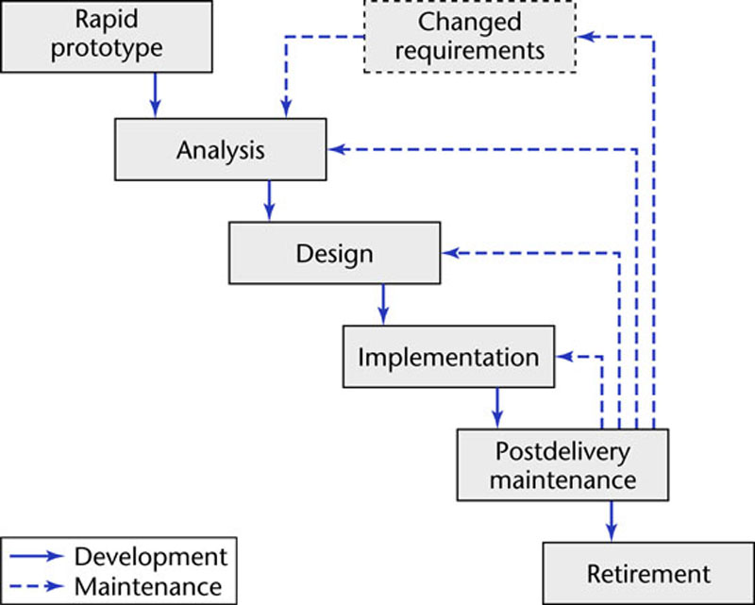
5. Rapid Prototyping Model
Notes:
Often, a customer defines a set of general objectives for software but does not identify detailed input, processing, or output requirements.
In other cases, the developer may be unsure of the efficiency of an algorithm, the adaptability of an operating system or the form that human/machine interaction should take.

Slide 23
5. Rapid Prototyping Model
Prototyping is used for:
understanding the requirements for the user interface
can start with initial requirements to clarify what is really needed
examining feasibility of a proposed design approach
exploring system performance issues
Preferred for new technology projects.
A prototype has only a limited capability.
Prototyping often takes 3-4 months.
Notes:
Ideally, the prototype serves as a mechanism for identifying software requirements.

Slide 24
5. Prototype Development and Retirement
May be based on rapid prototyping languages or tools
May involve leaving out functionality
Prototype should focus on areas of the product that are not well-understood;
Error checking and recovery may not be included in the prototype;
Focus on functional rather than non-functional requirements such as reliability and security
Prototypes should be discarded after development as they are not a good basis for a production system:
It may be impossible to tune the system to meet non-functional requirements;
Prototypes are normally undocumented;
The prototype structure is usually degraded through rapid change;
The prototype probably will not meet normal organizational quality standards.

Slide 25
5. Rapid Prototyping Model Pros and Cons
Pros
Cons
Improved system usability.
A closer match to users’ real needs.
Improved design quality.
Improved maintainability.
Reduced development effort.
Usually the customer insists on «small modifications» to prototype system after seeing sth appears to be a working version of the software.
The developer may use inappropriate components for building prototype quickly. By the time, they get comfortable with the choices and forget all reasons why there were inappropriate. Less-then-ideal choices become a part of the system.
Notes:
The customer sees what appears to be a working version of the software,
unaware that the prototype is held together “with chewing gum and baling
wire,” unaware that in the rush to get it working no one has considered overall
software quality or long-term maintainability. When informed that the
product must be rebuilt so that high levels of quality can be maintained, the
customer cries foul and demands that "a few fixes" be applied to make the
prototype a working product. Too often, software development management
relents.
The developer often makes implementation compromises in order to get a
prototype working quickly. An inappropriate operating system or programming
language may be used simply because it is available and known; an
inefficient algorithm may be implemented simply to demonstrate capability.
After a time, the developer may become familiar with these choices and forget
all the reasons why they were inappropriate. The less-than-ideal choice
has now become an integral part of the system.

Slide 26
6. Spiral Model
The spiral model is a software development process combining the elements of both design and prototyping-in-stages.
This model of development combines the features of the prototyping model and the waterfall model.
The spiral model is intended for large, expensive and complicated projects.
Process is represented as a spiral rather than as a sequence of activities with backtracking.
Each loop in the spiral represents a phase in the process.
No fixed phases such as specification or design - loops in the spiral are chosen depending on what is required.
Risks are explicitly assessed and resolved throughout the process.

Slide 27
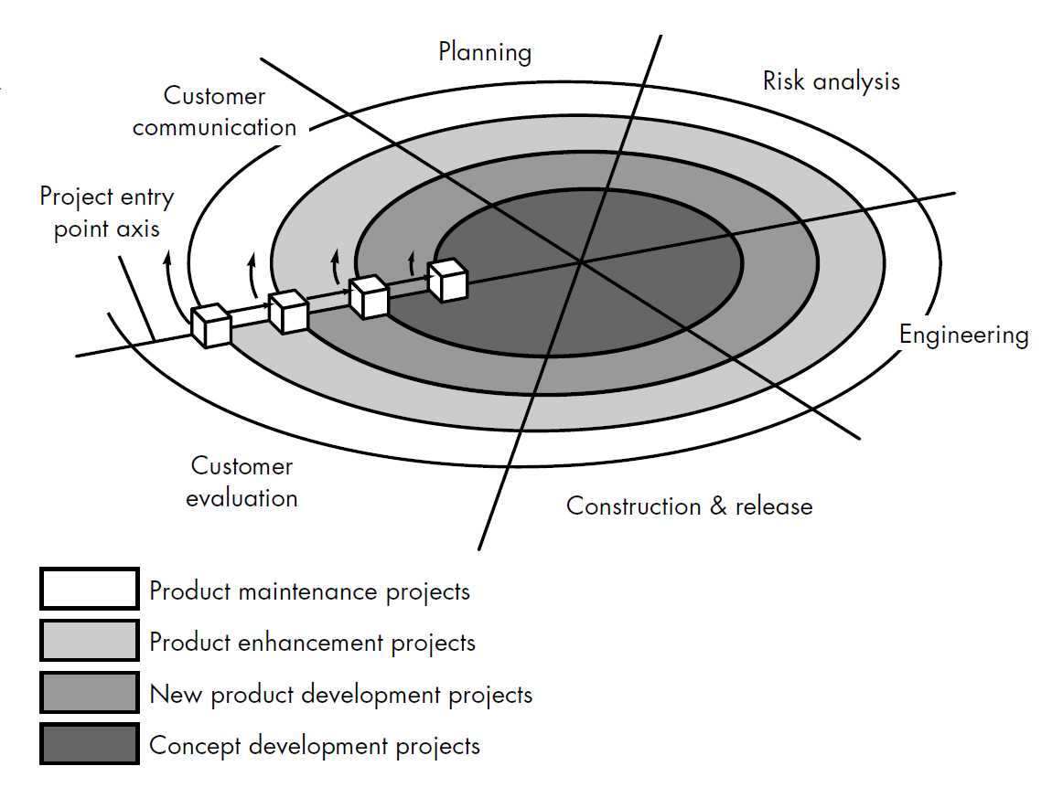
6. Spiral Model
Notes:
Typically, there are between three and six task regions
• Customer communication—tasks required to establish effective communication between developer and customer.
• Planning—tasks required to define resources, timelines, and other project related information.
• Risk analysis—tasks required to assess both technical and management risks.
• Engineering—tasks required to build one or more representations of the application.
• Construction and release—tasks required to construct, test, install, and provide user support (e.g., documentation and training).

Slide 28
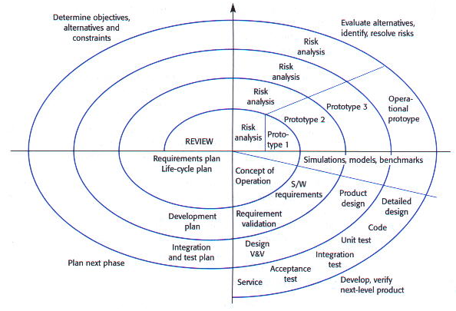
6. Spiral Model

Slide 29
6. Spiral Model Sectors
Objective setting
Specific objectives for the phase are identified.
Risk assessment and reduction
Risks are assessed and activities put in place to reduce the key risks.
Development and validation
A development model for the system is chosen which can be any of the generic models.
Planning
The project is reviewed and the next phase of the spiral is planned.
An example project built with spiral model:
https://xbsoftware.com/blog/software-development-life-cycle-spiral-model/

Slide 30
7. The Unified Process
The Unified Process (UP) is a “use-case driven, iterative and incremental” software process model closely aligned with Object-Oriented Analysis and Design.
A modern generic process derived from the work on the UML and associated process.
Brings together aspects of the 3 generic process models discussed previously.
Normally described from 3 perspectives
A dynamic perspective that shows phases over time;
A static perspective that shows process activities;
A practive perspective that suggests good practice.
Each phase ends at a major milestone and contains one or more iterations.
An iteration is a distinct sequence of activities with an established plan and evaluation criteria, resulting in an executable release.

Slide 31
7. The Unified Process - II
Inception
Elaboration
Construction
Transition
Iteration 1
Iteration 2
Iteration 3
Each iteration is defined in terms of the scenarios it implements.
Notes:
Iterative and Incremental
The Unified Process is an iterative and incremental development process. The Elaboration, Construction and Transition phases are divided into a series of timeboxed iterations. (The Inception phase may also be divided into iterations for a large project.) Each iteration results in an increment, which is a release of the system that contains added or improved functionality compared with the previous release.
Although most iterations will include work in most of the process disciplines (e.g. Requirements, Design, Implementation, Testing) the relative effort and emphasis will change over the course of the project.
Use Case Driven
In the Unified Process, use cases are used to capture the functional requirements and to define the contents of the iterations. Each iteration takes a set of use cases or scenarios from requirements all the way through implementation, test and deployment.
Architecture Centric
The Unified Process insists that architecture sit at the heart of the project team's efforts to shape the system. Since no single model is sufficient to cover all aspects of a system, the Unified Process supports multiple architectural models and views.
One of the most important deliverables of the process is the executable architecture baseline which is created during the Elaboration phase. This partial implementation of the system serves to validate the architecture and act as a foundation for remaining development.
Risk Focused
The Unified Process requires the project team to focus on addressing the most critical risks early in the project life cycle. The deliverables of each iteration, especially in the Elaboration phase, must be selected in order to ensure that the greatest risks are addressed first

Slide 32
7. The Unified Process–Workflows&Phases
Workflow is Technical context of a step.
Phase is Business context of a step.
Person-hours
Time

Slide 33
7. The Unified Process Phases-I
1. Inception
2. Elaboration
Establish business rationale for project
Decide project scope
Identify actors and use cases
Work Products (artifacts):
Vision document
Initial use-case model
Initial risk assessment
Project plan
Prototype
Collect more detailed requirements
Do high-level analysis and design
Establish baseline architecture
Create construction plan
Work Products:
Use-case model
Non-functional requirements
Analysis model
Software architecture description
Preliminary design model
Preliminary user manual
Notes:
Inception Phase
Inception is the smallest phase in the project, and ideally it should be quite short. If the Inception Phase is long then it may be an indication of excessive up-front specification, which is contrary to the spirit of the Unified Process.
The following are typical goals for the Inception phase.
Establish a justification or business case for the project
Establish the project scope and boundary conditions
Outline the use cases and key requirements that will drive the design tradeoffs
Outline one or more candidate architectures
Identify risks
Prepare a preliminary project schedule and cost estimate
The Lifecycle Objective Milestone marks the end of the Inception phase.
Develop an approximate vision of the system, make the business case, define the scope, and produce rough estimate for cost and schedule.
Elaboration Phase
During the Elaboration phase the project team is expected to capture a healthy majority of the system requirements. However, the primary goals of Elaboration are to address known risk factors and to establish and validate the system architecture. Common processes undertaken in this phase include the creation of use case diagrams, conceptual diagrams (class diagrams with only basic notation) and package diagrams (architectural diagrams).
The architecture is validated primarily through the implementation of an Executable Architecture Baseline. This is a partial implementation of the system which includes the core, most architecturally significant, components. It is built in a series of small, timeboxed iterations. By the end of the Elaboration phase the system architecture must have stabilized and the executable architecture baseline must demonstrate that the architecture will support the key system functionality and exhibit the right behavior in terms of performance, scalability and cost.
The final Elaboration phase deliverable is a plan (including cost and schedule estimates) for the Construction phase. At this point the plan should be accurate and credible, since it should be based on the Elaboration phase experience and since significant risk factors should have been addressed during the Elaboration phase.

Slide 34
7. The Unified Process Phases-II
3. Construction
4. Transition
Build, test and validate the project
Work Products:
Design model
Software components
Test plan and test cases
Support documenatation
User manuals
Installation manuals
Description of current increment
Beta-test
Tune performance
Train users
Work Products:
Delivered software increment
Beta test results
General user feedback
Notes:
Construction Phase
Construction is the largest phase in the project. In this phase the remainder of the system is built on the foundation laid in Elaboration. System features are implemented in a series of short, timeboxed iterations. Each iteration results in an executable release of the software. It is customary to write full text use cases during the construction phase and each one becomes the start of a new iteration. Common UML (Unified Modelling Language) diagrams used during this phase include Activity, Sequence, Collaboration, State (Transition) and Interaction Overview diagrams.
Transition Phase
The final project phase is Transition. In this phase the system is deployed to the target users. Feedback received from an initial release (or initial releases) may result in further refinements to be incorporated over the course of several Transition phase iterations. The Transition phase also includes system conversions and user training.

Slide 35
Other Process Models
Agile Methodologies Will be covered next week.
Formal Methods Model Emphasizes the mathematical specification of requirements Will be covered last week in «Advanced Software Engineering» topics.
Aspect-Oriented Software Development Provides a process and methodological approach for defining, specifying, designing, and constructing aspects

Slide 36
Wrap-up
Different life-cycle models have been presented
Each with its own strengths and weaknesses
Criteria for deciding on a model include:
The organization
Its management
The skills of the employees
The nature of the product
Best suggestion
“Mix-and-match” life-cycle model

Slide 37
Next Week
We will discuss agile software development approach and practices in detail!

